Slide 1


SUPPORTING HEALTH COORDINATION, ASSESSMENTS, PLANNING, ACCESS TO HEALTH CARE AND CAPACITY BUILDING IN MEMBER STATES UNDER PARTICULAR MIGRATORY PRESSURE — 717275/SH-CAPAC
MODULE 1: Refugees and migrants' health policies
Unit 3: Migrants in an irregular situation
Prepared by:
Amets Suess Schwend
Andalusian School of Public Health

Slide 2
Outline of the session
Compulsory activity 1: Presentation
  Concepts and terminologies
  Comparative studies in the European context
  Impact of the current economic crisis
  Barriers for effective access to health care
  Recommendations from comparative reports
Compulsory activity 2: Reading
Compulsory activity 3: Identifying strategies for improving access to health care for migrants in an irregular situation
Optional activity: Mapping an intersectoral action for facilitating access to health care for migrants in an irregular situation
Notes:
Experiences related to interculturalism, intercultural competence and cultural diversity

Slide 3
Compulsory activity 1:
Presentation

Slide 4

Concepts and terminologies
Concepts and terminologies
  “Illegal migrants”
  “Irregular migrants”
  “Migrants in an irregularized situation”
  “Undocumented migrants”
  “Migrants in an 'irregular' situation”
Theoretical and political discussion related to terminology use.
Complex character of the migration status.
  Terminology use in the framework of the SH-CAPAC project:
    “Migrants in an irregular situation"
    Based on the idea that the person is not “irregular” / “illegal”, the legal framework contributes to the lack of documents, irregularizing the migrants' administrative status.
Duvell, et al. 2008; Global Commission on International Migration 2005;Mock-Muñoz de Luna, et al. 2015; Morehouse, et al. 2001; PICUM 2014; Vollmer 2011.

Slide 5
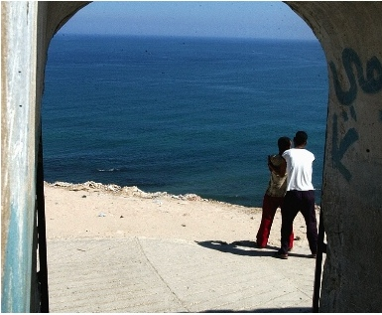
Migrants in an irregular situation:
Comparative studies in the European context
  Comparative studies
    Individual authors
    European agencies
    Professional associations
    Civil society organizations
  Relevant aspects
    International and European Human Rights framework
    Analysis of health care entitlements of migrants in an irregular situation.
    Barriers in the effective access to health care.
    Health risks related to limitation / absence of access to health care.
    Role of local and regional health policies.
    Impact of the current economic and systemic crisis.
    Recommendations.
Biswas, et al. 2011; Cuadra 2011; Dauvrin, et al. 2012; Duvell, et al. 2009; FRA, European Union Agency for Fundamental Rights 2011a, 2011b; HUMA Network, et al. 2009; 2010; Karl-Trummer et al. 2010; Médicins du Monde, et al. 2009, 2012, 2013; PICUM, et al. 2009a, 2009b, 2009c, 2010, 2012, 2013a, 2013b, 2014a, 2014b; Ruiz-Casares, et al. 2010; Suess, et al. 2014a; Woodward, et al. 2014.

Slide 6
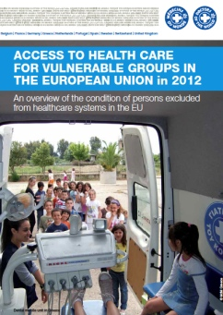
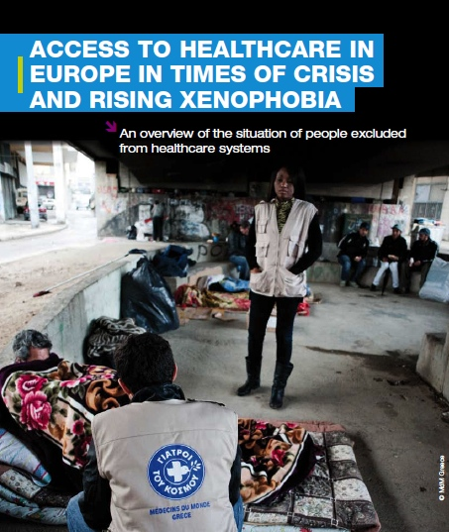
Migrants in an irregular situation:
Impact of the current economic crisis
Current situation of population groups in situation of social vulnerability, including migrants in an irregular situation, in 5 European cities (MdM 2012) and 14 cities of 7 European countries (MdM 2013).
Increase of unemployment and xenophobia.
Limitation of health care entitlements.
Introduction of fees in the access to health care services.
Increase of barriers in the effective access to health care.
Deterioration of self-perceived health.
MdM, Médicins du Monde 2012, 2013.

Slide 7
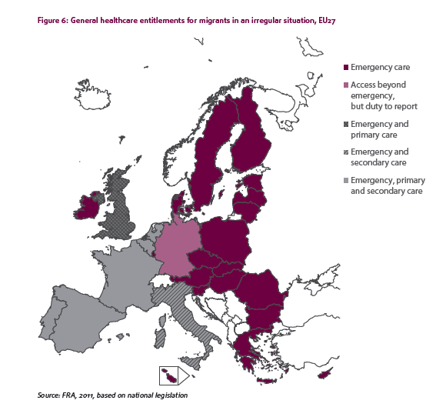
Migrants in an irregular situation:
Health care entitlements
2011
Recent developments, among them:
2013:
Sweden:
Law on health and medical care for foreigners living in Sweden without necessary permits
2012:
Spain:
Limitation of access to health care by means of the Royal Decree-law 16/2012
FRA, European Union Agency for Fundamental Rights 2011a; PICUM 2014b.

Slide 8

Migrants in an irregular situation:
Barriers for effective access to health care (I)
Limitation or absence of health care entitlements.
Lack of awareness of existing entitlements by professionals, administrative staff and migrants.
Complexity of administrative procedures.
Difficulties in reimbursement and co-payment systems in case of low economic resources.
Fear of denunciation.
Biswas, et al. 2011; Cuadra 2011; Dauvrin, et al. 2012; Duvell, et al. 2009; FRA, European Union Agency for Fundamental Rights 2011a, 2011b; HUMA Network, et al. 2009; 2010; Karl-Trummer et al. 2010; Médicins du Monde, et al. 2009, 2012, 2013; PICUM, et al. 2009a, 2009b, 2009c, 2010, 2012, 2013a, 2013b, 2014a, 2014b; Ruiz-Casares, et al. 2010; Suess et al. 2014a; Woodward, et al. 2014.

Slide 9
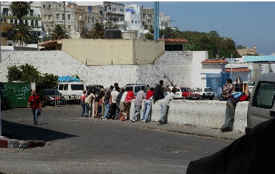
Migrants in an irregular situation:
Barriers for effective access to health care (II)
Cultural and idiomatic aspects.
Previous experiences of discrimination.
Precariousness of the socioeconomic situation, with frequent changes or absence of a permanent residence.
Cases of denied access despite being entitled.
Fear of a negative impact of an HIV+ diagnosis on the residence authorization process.
Difficulties in accessing appropriate health care in detention centers.
Amnesty International 2007; Biswas, et al. 2011; Committee on Civil Literties, Justice and Home Affairs, 2007; Cuadra 2011; Dauvrin, et al. 2012; Duvell, et al. 2009; FRA, European Union Agency for Fundamental Rights 2011a, 2011b; HUMA Network, et al. 2009; 2010; Karl-Trummer et al. 2010; JRS-Europe, 2010; Médicins du Monde, et al. 2009, 2012, 2013; Médicins Sans Frontieres s.a.; PICUM, et al. 2009a, 2009b, 2009c, 2010, 2012, 2013a, 2013b, 2014a, 2014b; Ruiz-Casares, et al. 2010; Suess et al. 2014a; UN 2012, 2013; Woodward, et al. 2014.

Slide 10
Migrants in an irregular situation:
Recommendations from comparative reports
Health care entitlements
  Equality of conditions in relation to public coverage, reimbursement or co-payment for all people residing in a country, regardless of nationality, administrative status or employment situation.
  Access to all health care levels, not only emergency care.
  Cessation of a migration control during the health care delivery.
  Maintenance of health care entitlements in the situation of economic crisis.
Amnesty International 2007; Biswas, et al. 2011; Committee on Civil Literties, Justice and Home Affairs, 2007; Cuadra 2011; Dauvrin, et al. 2012; Duvell, et al. 2009; FRA, European Union Agency for Fundamental Rights 2011a, 2011b; HUMA Network, et al. 2009; 2010; Karl-Trummer et al. 2010; JRS-Europe, 2010; Médicins du Monde, et al. 2009, 2012, 2013; Médicins Sans Frontieres s.a.; PICUM, et al. 2009a, 2009b, 2009c, 2010, 2012, 2013a, 2013b, 2014a, 2014b; Ruiz-Casares, et al. 2010; Suess et al. 2014a; UN 2012, 2013; Woodward, et al. 2014.

Slide 11
Migrants in an irregular situation:
Recommendations from comparative reports
Improvement of effective access to health care
  Removal of cultural, idiomatic, social and structural barriers.
  Health care delivery without discrimination.
  Improvement of health care in detention centers.
  Role of local and regional policies and interventions.
Amnesty International 2007; Biswas, et al. 2011; Committee on Civil Literties, Justice and Home Affairs, 2007; Cuadra 2011; Dauvrin, et al. 2012; Duvell, et al. 2009; FRA, European Union Agency for Fundamental Rights 2011a, 2011b; HUMA Network, et al. 2009; 2010; Karl-Trummer et al. 2010; JRS-Europe, 2010; Médicins du Monde, et al. 2009, 2012, 2013; Médicins Sans Frontieres s.a.; PICUM, et al. 2009a, 2009b, 2009c, 2010, 2012, 2013a, 2013b, 2014a, 2014b; Ruiz-Casares, et al. 2010; Suess et al. 2014a; UN 2012, 2013; Woodward, et al. 2014.

Slide 12
Compulsory activity 2

Slide 13

Compulsory activity 2:
Reading
Reading
  In the following document, read the chapter on health care, p. 71-84:
    FRA, European Union Agency for Fundamental Rights. Fundamental Rights of Migrants in an Irregular Situation in the European Union. Luxembourg: Publications Office of the European Union, 2011a.

Slide 14
Compulsory activity 3

Slide 15
Compulsory activity 3:
Strategies for improving access to health care
for migrants in an irregular situation
In the forum:
  Upload a post identifying strategies for improving access to health care for migrants in an irregular situation in your region / country.

Slide 16
Optional activity

Slide 17

Optional activity:
Mapping intersectoral actions for facilitating access to health care for migrants in an irregular situation
Individually
  Draft a map describing an intersectoral action for facilitating access to health care for migrants in an irregular situation, in your own institutional, local, regional or national context, including:
    Relevant stakeholders and resources
    Existing interactions and barriers
    Aspects and strategies for an 'ideal intersectoral coordination'
In the forum:
  Upload the map indicating the most relevant aspects.
Methodology: CIMAS 2009; CommunityToolBox 2014; Risler et al. 2013.
.

Slide 18
Thank you!
You can use the Unit forum for questions …
Pictures: Andalusian Childhood Observatory (OIA, Observatorio de la Infancia de Andalucía) 2014; Josefa Marín Vega 2014; RedIsir 2014; Morguefile 2014.

Slide 19
References
Amnesty International. Migration-Related Detention: A research guide on human rights standards relevant to the detention of migrants, asylum-seekers and refugees. London: AI, 2007. http://www.refworld.org/pdfid/476b7d322.pdf (retrieved: August 9, 2016).
Biswas D, Toebes B, Hjern A, Ascher H, Norredam M. Access to health care for undocumented migrants from a human rights perspective: a comparative study of Denmark, Sweden, and the Netherlands. Health and Human Rights 2012;14:2:49-60.
Cuadra BC. Right of access to health care for undocumented migrants in EU: a comparative study of national policies. Eur J Public Health 2011;22:267–271.
Chiarenza A, Horvat L, Ciannameo A, Vaccaro G, Lanting K, Bodewes A, Suurmond J. Final Report Review of existing training materials. MEM-TP, Training packages for health professionals to improve access and quality of health services for migrants and ethnic minorities, including the Roma. Granada, Reggio Emilia, Amsterdam: Andalusian School of Public Health, AYSL of Reggio Emilia, University of Amsterdam, 2015.
CIMAS, Observatorio Internacional de Ciudadanía y Medio Ambiente Sostenible. Metodologías Participativas. Manual, 2009. http://www.redcimas.org/wordpress/wp-content/uploads/2012/09/manual_2010.pdf (retrieved: August 9, 2016).
CommunityToolBox. Section 3. Our Model of Practice: Building Capacity for Community and System Change. http://ctb.ku.edu/en/table-of-contents/overview/model-for-community-change-and-improvement (retrieved: August 9, 2016).
Dauvrin M, Lorant V, Sandhu S, et al. Health care for irregular migrants: pragmatism across Europe. A qualitative study. BMC Res Notes 2012;5:99.
Duvell F, Triandafyllidou A, Vollmer B. Ethical issues in irregular migration research. Report on Ethical Issues, Deliverable D2 prepared for Work Package 2 of the research project CLANDESTINO Undocumented Migration: Counting the Uncountable. Data and Trends Across Europe, funded by the 6th Framework Programme for Research and Technological Development Research DG, European Commission, 2008. http://irregular-migration.net/typo3_upload/groups/31/4.Background_Information/4.1.Methodology/EthicalIssuesIrregularMigration_Clandestino_Report_Nov09.pdf (retrieved: August 9, 2016).
European Commission. Migrant access to social security and healthcare: policies and practice. European Migration Network Study 2014. Brussels: European Commission, 2014. http://ec.europa.eu/dgs/home-affairs/what-we-do/networks/european_migration_network/reports/docs/emn-studies/emn_synthesis_report_migrant_access_to_social_security_2014_en.pdf (retrieved: August 9, 2016).
FRA, European Union Agency for Fundamental Rights. Fundamental Rights of Migrants in an Irregular Situation in the European Union. Luxembourg: Publications Office of the European Union, 2011a. http://fra.europa.eu/sites/default/files/fra_uploads/1827-FRA_2011_Migrants_in_an_irregular_situation_EN.pdf (retrieved: August 9, 2016).
FRA, European Union Agency for Fundamental Rights. Migrants in an Irregular Situation: Access to Health Care in 10 European Union Member States. Luxembourg: Publications Office of the European Union, 2011b. http://fra.europa.eu/sites/default/files/fra_uploads/1771-FRA-2011-fundamental-rights-for-irregular-migrants-healthcare_EN.pdf (retrieved: August 9, 2016).
GCIM, Global Commission on International Migration. Migration in an interconnected world: New directions for action. Report of the Global Commission on International Migration. Geneva: GCIM, 2005. http://www.queensu.ca/samp/migrationresources/reports/gcim-complete-report-2005.pdf (retrieved: August 9, 2016).
HUMA Network Health for Undocumented Migrants and Asylum Seekers, Collantes S, Soler A, Klorek N, Maśliński K. Access to Health Care and Living Conditions of Asylum Seekers and Undocumented Migrants in Cyprus, Malta, Poland and Romania. Paris, Brussels, Madrid: HUMA Network, 2011. http://ec.europa.eu/ewsi/UDRW/images/items/docl_20498_605665099.pdf (retrieved: August 9, 2016).

Slide 20
References
HUMA Network, Health for Undocumented Migrants and Asylum Seekers, Collantes S. Access to Health Care for Undocumented Migrants and Asylum Seekers in 10 EU Countries. Law and Practice. Paris, Brussels, Madrid: HUMA Network, 2009. http://www.episouth.org/doc/r_documents/Rapport_huma-network.pdf (retrieved: August 9, 2016).
HUMA Network, Health for Undocumented Migrants and Asylum Seekers, Collantes S. Are Undocumented Migrants and Asylum Seekers Entitled to Access Health Care in the EU? A Comparative Overview in 16 Countries. Paris, Brussels, Madrid: HUMA Network, 2010. http://www.epim.info/wp-content/uploads/2011/02/HUMA-Publication-Comparative-Overview-16-Countries-2010.pdf (retrieved: August 9, 2016).
IOM, International Organization for Migration. EQUI-Health, Fostering health provision for migrants, the Roma, and other vulnerable groups, 2015. http://equi-health.eea.iom.int/ (retrieved: August 9, 2016).
Jefatura del Estado. Real Decreto-ley 16/2012, de 20 de abril, de medidas urgentes para garantizar la sostenibilidad del Sistema Nacional de Salud y mejorar la calidad y seguridad de sus prestaciones. BOE, Boletín Oficial del Estado Nº 98, 24 de abril de 2012.
Karl-Trummer U, Novak-Zezula S. Health Care in Nowhereland, Improving Services for Undocumented Migrants in the EU. Vienna: Centre for Health and Migration, 2010.
Médicins du Monde (Doctors of the World), Chauvin D, Simonnot N, Vanbiervliet F, et al. Access to Health Care in Europe in Times of Crisis and Rising Xenophobia: An Overview of the Situation of People Excluded from Health Care Systems. Paris: Médicins du Monde, 2013. http://b.3cdn.net/droftheworld/d137240498b91ca33e_jhm62yjg1.pdf (retrieved: August 9, 2016).
Médicins du Monde (Doctors of the World), Chauvin P, Mestre MC, Simonnot N. Access to Health Care for Vulnerable Groups in the European Union in 2012. An Overview of the Condition of Persons Excluded from Health Care Systems in the EU. Paris: Médicins du Monde, 2012. http://www.doktersvandewereld.be/sites/www.doktersvandewereld.be/files/publicatie/attachments/eu_vulnerable_groups_2012_mdm.pdf (retrieved: August 9, 2016).
Médicins du Monde (Doctors of the World), European Observatory on Access to Health Care, Chauvin P, Parizot I, Simonnot N. Access to Health Care for Undocumented Migrants in 11 European Countries. Paris: Médicins du Monde, 2009. http://mdmgreece.gr/attachments/283_huma%20en.pdf (retrieved: August 9, 2016). Mock-Muñoz de Luna C, Ingleby D, Graval E, Krasnik A. Synthesis Report. MEM-TP, Training packages for health professionals to improve access and quality of health services for migrants and ethnic minorities, including the Roma. Granada, Copenhagen: Andalusian School of Public Health, University of Copenhagen, 2015. http://www.mem-tp.org/pluginfile.php/619/mod_resource/content/1/MEM-TP_Synthesis_Report.pdf (retrieved: August 9, 2016). Morehouse C, Blomfield M. Irregular Migration in Europe. Washington DC: Migration Policy Institute, 2011. http://www.migrationpolicy.org/research/TCM-irregular-migration-europe (retrieved: August 9, 2016).
Petrova-Benedict R, Samuilova M. Guidelines for Border Management and Detention Procedures Involving Migrants: A Public Health Perspective. PHBLM Project. Increasing Public Health Safety alongside the New Eastern European Border Line. Brussels: IOM, International Organization for Migration, 2010. http://www.iom.int/jahia/webdav/shared/shared/mainsite/activities/health/Guidelines-Border-Management-and-Detention-Procedures-Public-Health-Perspective.pdf (retrieved: August 9, 2016).
PICUM, Platform for International Cooperation on Undocumented Migrants. Why ‘Undocumented’ or ‘Irregular’? Brussels: PICUM, s.a. http://picum.org/picum.org/uploads/file_/TerminologyLeaflet_reprint_FINAL.pdf (retrieved: August 9, 2016).
PICUM, Platform for International Cooperation on Undocumented Migrants, Bicocchi L, LeVoy M. Undocumented Children in Europe: Invisible Victims of Immigration Restrictions. Brussels: PICUM, 2009. http://picum.org/picum.org/uploads/publication/Undocumented%20Children%20in%20Europe%20EN.pdf (retrieved: August 9, 2016).

Slide 21
References
PICUM, Platform for International Cooperation on Undocumented Migrants. PICUM’s Main Concerns about the Fundamental Rights of Undocumented Migrants in Europe. Brussels: PICUM, 2010. http://picum.org/picum.org/uploads/publication/Annual%20Concerns%202010%20EN.pdf (retrieved: August 9, 2016).
PICUM, Platform for International Cooperation on Undocumented Migrants, Geddie E, LeVoy M, Nguyen KA, Mateos M, Iengar S. Strategies to End Double Violence Against Undocumented Women – Protecting Rights and Ensuring Justice. Brussels: PICUM, 2012. http://picum.org/picum.org/uploads/publication/Double%20Violence%20Against%20Undocumented%20Women%20-%20Protecting%20Rights%20and%20Ensuring%20Justice.pdf (retrieved: August 9, 2016).
PICUM, Platform for International Cooperation on Undocumented Migrants, Keith L, Stricker B, Mateos M. Children First and Foremost. A guide to realising the rights of children and families in an irregular migration situation. Brussels: PICUM, 2013a. http://picum.org/picum.org/uploads/publication/Children%20Conference%20report_26%20February%202013_EN.pdf (retrieved: August 9, 2016).
PICUM, Platform for International Cooperation on Undocumented Migrants, Geddie E, LeVoy M, Soova K, Manieri MG. Advocating for the Rights of Undocumented Migrants: An Overview of PICUM’s Work Since 2001. Brussels: PICUM, 2013b. http://picum.org/picum.org/uploads/publication/PICUM%2010%20Year%20report%20EN.pdf (retrieved: August 9, 2016).
PICUM, Platform for International Cooperation on Undocumented Migrants, Cortina J, Raphael A, Elie J. Human Rights of Undocumented Adolescents and Youth. Brussels: PICUM, 2014a.http://www.globalmigrationgroup.org/sites/default/files/uploads/gmg-topics/mig-data/Human-Rights-of-Undocumented-Adolescents-Youth.pdf (retrieved: August 9, 2016).
PICUM, Platform for International Cooperation on Undocumented Migrants. Access to Health Care for Undocumented Migrants in Europe: The Key Role of Local and Regional Authorities. Brussels: PICUM, 2014b. http://picum.org/picum.org/uploads/publication/PolicyBrief_Local%20and%20Regional%20Authorities_AccessHealthCare_UndocumentedMigrants_Oct.2014.pdf (retrieved: August 9, 2016).
Risler J, Ares P. Manual de mapeo colectivo: recursos cartográficos críticos para procesos territoriales de creación colaborativa. Buenos Aires: Tinta Limón, 2013. http://boek861.com/archivos/proyectos_rec/pry/0%20MAPEO.pdf (retrieved: August 9, 2016).
Ruiz-Casares M, Rousseau C, Derluyn I, Watters C, Crépeau F. Right and access to healthcare for undocumented children: Addressing the gap between international conventions and disparate implementations in North America and Europe. Social Science & Medicine 2010;70:329-336.
Suess A, Ruiz Pérez I, Ruiz Azarola A, March Cerdà JC. The right of access to health care for undocumented migrants: a revision of comparative analysis in the European context. European Journal of Public Health 2014;24(5):712-720. doi: 10.1093/eurpub/cku036.
Svensk författningssamling. Lag (2008:344) om hälso- och sjukvård åt asylsökande m. fl. http://www.notisum.se/rnp/sls/sfs/20080344.pdf (retrieved: August 9, 2016).
Svensk författningssamling. Lag (2013;407) om hälso- och sjukvård till vissa utlänningar som vistas i Sverige utan nödvändiga tillstånd. http://rkrattsdb.gov.se/SFSdoc/13/130407.pdf (retrieved: August 9, 2016).
UN, United Nations, Human Rights Council. Report of the Special Rapporteur on the human rights of migrants, Detention of migrants in an irregular situation. François Crépeau, 2012. http://www.ohchr.org/Documents/HRBodies/HRCouncil/RegularSession/Session20/A-HRC-20-24_en.pdf (retrieved: August 9, 2016).

Slide 22
References
UN, United Nations, Human Rights Council. Report of the Special Rapporteur on the human rights of migrants, François Crépeau, Regional study: management of the external borders of the European Union and its impact on the human rights of migrants, 2012. http://www.ohchr.org/Documents/HRBodies/HRCouncil/RegularSession/Session23/A.HRC.23.46_en.pdf (retrieved: August 9, 2016).
Vollmer B. Briefing. Irregular Migration in the UK: Definitions, Pathways and Scale. Oxford: The Migration Observatory, University of Oxford, 2011. http://www.migrationobservatory.ox.ac.uk/sites/files/migobs/Briefing%20-%20Irregular%20Migration_0.pdf (retrieved: August 9, 2016).
Woodward A, Howard N, Wolffers I. Health and access to care for undocumented migrants living in the European Union: a scoping review. Health Policy and Planning 2014;29:818-830.

Slide 23






© – 2016 – Escuela Andaluza de Salud Pública. All rights reserved. Licensed to the Consumers, Health, Agriculture and Food Executive Agency (CHAFEA) under conditions.
This document is part of the project ‘717275 / SH-CAPAC’ which has received funding from the European Union’s Health Programme (2014-2020). The content of this report represents the views of the author only and is his/her sole responsibility; it cannot be considered to reflect the views of the European Commission and/or the Consumers, Health, Agriculture and Food Executive Agency or any other body of the European Union. The European Commission and the Agency do not accept any responsibility for use that may be made of the information it contains.
The document uses contents produced under the EU Health Programme (2008-2013) in the frame of service contract nr. 20136209 with the Consumers, Health, Agriculture and Food Executive Agency Unit (Chafea) acting under the mandate from the European Commission: Project “Training packages for health professionals to improve access and quality of health services for migrants and ethnic minorities, including the Roma – MEM-TP” carried out by the Andalusian School of Public Health, EASP (Spain) as consortium leader and Faculty of Health and Medical Sciences of the University of Copenhagen (Denmark), Azienda Unità Sanitaria Locale Reggio Emilia (Italy) and Academisch Medisch Centrum bij de Universiteit van Amsterdam (The Netherlands).

