Slide 1
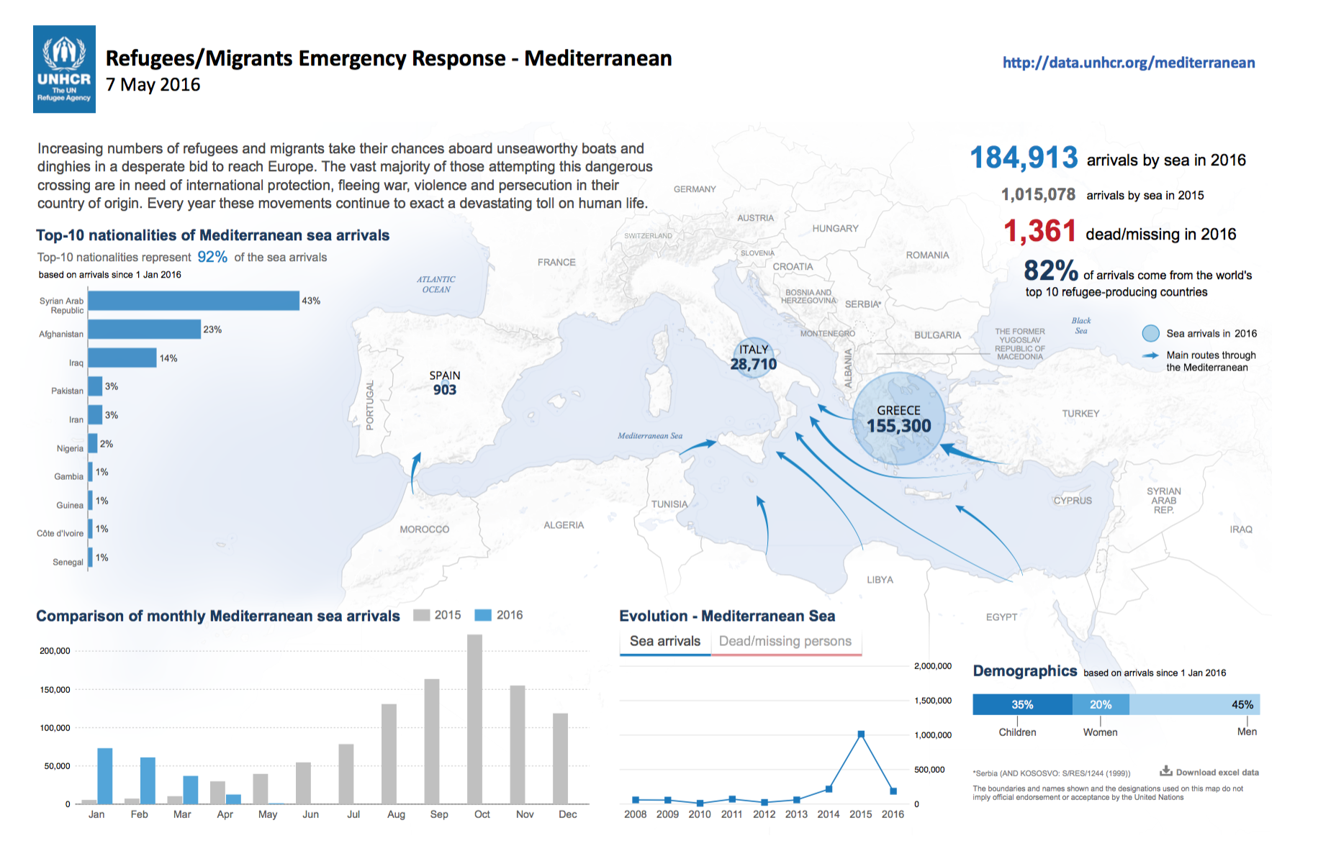
Module 3 Unit 3: Health Prevention
1. Demographics
2. Refugees Health Issues
Community adquired diseases
The health problems of refugees are similar to those of the rest of the population.
Mental Health: Adjustment disorders
Psychologic symptoms becaus of the stress as a result of migration or life conditions
Genetic disorders
Some genetic diseases are more frequent in other populations
Tropical infectious diseases
A group of Infections that are especially common in regions of Africa, Asia and the Americas
Cosmopolitan diseases
Diseases not eliminated in the European region but are associated primarily with poverty
Although many physicians think of infectious diseases when dealing with refugees, other diagnoses such as musculoskeletal pain and mental health issues are actually more prevalent

Slide 2
3. Refugee seeking healthcare
Refugee who consults a physician (initial contact)
Adequate access to Primary Health Care should be established as early as possible
Priorizing problems
(patient-centered approach)
1º Address reason for visiting and schedule pending problems
2º Protocol for the newly arriving refugee
Anamnesis:
social risks assessment
health risks assessment
inmunization schedule
Physical examination and screening protocol
Is it possible to solve the problem in one consultation?
NO
YES
Scheduled consultation
Assess selected issues and plan intervention over pending problems
Refugee Health Assessment Protocol
Anamnesis
Physical examination
Screening protocol

Slide 3
4. Summary checklist for the medical examination for newly arriving refugees
Anamnesis
Physical examination
Country of origin and migratory history
Identify communication issues or cultural differences
Dwelling conditions
Social history: social networks and vulnerability
Asylum seeker status, and future perspectives in receiving country
Psychological risks
Chronic diseases and allergies
Previous health investigations or pre-departure medical examination
Current medications
Immunizations given
Nutritional status
Skin and mucosa (oral mucosa, throat, eyes)
Lymph nodes
Lungs and heart
Abdomen (organomegalies or masses)
Extremities
External genitalia
Basic psychological exploration
Screening protocol
General laboratory testing (blood count, glucose and serum chemistries, urinalysis, liver function tests)
Metabolopaties test in children under the age of 6 months
Disease-specific testing (depending on country of origin)
Serologies for hepatitis B, hepatitis C and varicella
HIV (informed consent) and syphilis
Intestinal and tissue invasive parasites
Malaria
Tuberculosis
Don’t forget:
Build a patient-centered relationship (call patient for his/her name, ask for preferences…)
To know social and cultural context
Health education intervention (dental care, exercise, nutrition counselling, assess for smoking and alcohol misuse, etc)
To ask for contraceptive needs
Remain alert for posible social needs, to refer to local social services
Offer the general population screening programmes (breast screening, cervical cancer screening)
Individualize the intervention depending on circumstances, don’t forget assessing patient health concerns first
Weekers J, Siem H. Is compulsory overseas medical screening of migrants justifiable? Public Health Rep. 1997 Sep-Oct;112(5):396-402.
Notes:
Fichas CCRH Otawa

Slide 4
5. Screening Protocol for Refugees (1/2)
Mental health screening
Clinical assessment is controversial. Be alert for signs and symptoms of post-traumatic disorder, depression, etc)
Infectous diseases
Hepatitis B
(HBsAg, anti-HBc, anti-HBs)
Adults and children where the seroprevalence is moderate or high (i.e. ≥ 2% HBsAg)
Vaccinate those who are susceptible (negative for all three markers)
Hepatitis C
All refugees from regions with prevalence of disease ≥ 3%
HIV
Screen with informed consent, all adolescents and adults from countries where HIV prevalence is ≥ 1%
Consider syphilis test for all persons ≥15 years old and for some children (risk criteria)
Intestinal parasites
Strongyloides (serologic test): Screen refugees newly arriving from Southeast Asia and Africa
Stools for ova and parasites: routine assesment for those who are symptomatic
Schistosoma (serologic test): Screen refugees newly arriving from Africa
Treat if positive: ivermectin (Strongyloides) or praziquantel (Schistosoma)
Malaria
Do not conduct routine screeing.
Suspect malaria if fever is present in any traveler coming from sub-Saharian Africa
Tuberculosis
Screen children, adolescents < 20 years of age and refugees between 20 and 50 years of age from countries with a high incidence of tuberculosis
If test results are positive, rule out active tuberculosis and then treat latent tuberculosis infection.
Notes:
La recomendacion sobre cribado de sifilis parece tener consenso
Valorar añadir Chagas.
Valorar pagina aparte para opciones de cribado de TBC latente y propuesta de tto.
Mencion a filariasis?

Slide 5
5. Screening Protocol for Refugees (2/2)
Chronic and noncommunicable diseases
In addition to the other special health considerations, refugees have the same common chronic conditions as non-refugee patients
Screen for chronic diseases, such as diabetes, hypertension, cholesterol, colorectal cancer etc. as appropriate based on age and risk factors as per usual practice.
Type 2 diabetes mellitus
Screen refugees > 35 years of age from ethnic groups at high risk for type 2 diabetes (those from South Asia, Latin America and Africa) with fasting blood glucose
The USPSTF recommends screening for abnormal blood glucose as part of cardiovascular risk assessment in adults aged 40 to 70 years who are overweight or obese
Iron-deficiency anemia
Screen refugee women of reproductive age, and children aged one to four years for iron-deficiency anemia (with hemoglobin)
If anemia is present, investigate and recommend iron supplementation if appropriate
Dental disease
Screen all immigrants for dental pain. Screen all immigrant children and adults for obvious dental caries and oral disease
Refer to a dentist or oral health specialist if necessary.
Vision health
Perform age-appropriate screening for visual impairment
Cervical citology
Screen sexually active women for cervical abnormalities by Papanicolaou (Pap) test
Breast cancer screening as appropiate for age. Lower priority for the first visit
Lower priority for the fisrt visit. Information, rapport and access to a female practitioner can improve uptake of screening and follow-up.
Contraception
Provide culturally sensitive, patient-centred contraceptive counselling (giving women their method of choice, having contraception on site and fostering a good interpersonal relationship).

Slide 6
6. Adult Immunizations Schedule: priorities
Most countries in Europe tend to recommend the same kind of vaccines for adults, but there could be some differencies (schedules, risk groups, funding and coverage, etc). Search for vaccunation recommendatios in your country.
Recommended adult inmmunization schedule for refugees
Vaccine | 14-17 years | 18-25 years | 26-49 years |  | 60-64 years | ≥65 years
Influenza | 1 dose annually depending on indication |  |  |  |  | 1 dose anually
Tetanus, diphteria (Td) | Complete the recommended five dose schedule if vaccination status unknown or incomplete |  |  |  | 1 dose | Complete
Pertusis (Tdpa) | 1 dose Tdap each pregnancy (third trimester)
Measles, mumps, rubella (MMR) | <35 years: 1 or 2 doses depending if vaccination is incomplete or unknown
Varicella | Persons with risk factor and seronegative. 2 doses
Hepatitis B | 3 doses (0-1-6 months)
Polio* | 3 doses (IPV, 0-1-12 months)
Refugees, asylum-seekers and migrants should be vaccinated without unnecessary delay according to the immunization schedule of the country in which they intend to. In adults <35 years, measles, mumps and rubella (MMR) should be priorities. * Assess the vaccination status of refugees and migrants from polio-affected countries* at the time of entry into the EU/EEA (Cameroon, Equatorial Guinea, Pakistan, Syrian Arabic Republic, Afghanistan, Ethiopia, Iraq, Israel, Somalia and Nigeria). People not vaccinated against polio or other diseases should be offered age-appropriate vaccinations and in accordance with the host country’s vaccination schedule.
WHO-UNHCR-UNICEF joint technical guidance: general principles of vaccination of refugees, asylum-seekers and migrants in the WHO European Region. 23 nov. 2015. Web page: euro.who.int/
CDC Adult Immunization Schedule – United States – 2016. Web page: cdc.gov/vaccines/schedules/hcp/adult.html
Notes:
Quizá haya que decir algo de la polio ya que viene refugiados de Afganistan y Pakistán
http://www.polioeradication.org/Dataandmonitoring/Poliothisweek/Poliocasesworldwide.aspx

Slide 7
7. About Health Promotion
Health promotion is the process of enabling people to increase control over, and to improve, their health. It moves beyond a focus on individual behaviour towards a wide range of social and environmental interventions.
The 8th Global Conference on Health Promotion was held in Helsinki, Finland from 10-14 June 2013.
We call on governments to fulfil their obligations to their peoples’ health and well-being by taking the following actions:
Commit to health and health equity as a political priority by adopting the principles of Health in All Policies and taking action on the social determinants of health.
Ensure effective structures, processes and resources that enable implementation of the Health in All Policies approach across governments at all levels and between governments.
Strengthen the capacity of Ministries of Health to engage other sectors of government through leadership, partnership, advocacy and mediation to achieve improved health outcomes.
Build institutional capacity and skills that enable the implementation of Health in All Policies and provide evidence on the determinants of health and inequity and on effective responses.
Adopt transparent audit and accountability mechanisms for health and equity impacts that build trust across government and between governments and their people.
Establish conflict of interest measures that include effective safeguards to protect policies from distortion by commercial and vested interests and influence.
Include communities, social movements and civil society in the development, implementation and monitoring of Health in All Policies, building health literacy in the population.
The Helsinki statement on Health in All Policies
The 8th Global Conference on Health Promotion, Helsinki, Finland, 10-14 June 2013. The Helsinki statement on Health in All Policies

